Slide 1
Breast Cancer Classification with Python
By - JAYANTI LAKHERA & VIDUSHI SINGH
En. No. - 03418011621 & 01818011621
B.Tech (AIML)

Slide 2
Introduction
The project is based on MACHINE LEARNING concept of Logistic Regression and is executed using python.
The dataset has been derived from the fine needle aspiration which is a type of biopsy procedure.
During this test a a thin needle is inserted in the part of the body where the tumour is suspected and the the sample of cells that come out with the needle are used to detect if the tumour exists.

Slide 3
BREAST CANCER
Unrestrained cell multiplication can disrupt the normal functioning of body, with the tumor progressively consuming vital nutrients and space required by healthy cells and tissues. Consequently, damage occurs within the brain. Breast cancer encompasses different types that can be categorized according to their characteristics and behavior. Certain types are noncancerous or benign, meaning they do not metastasize to other body parts and pose no immediate threat to life. On the other hand, there are cancerous or malignant types that have the potential to invade nearby tissues and spread to other areas of the body

Slide 4
CLASSIFICATION OF BREAST CANCER
Breast cancer can be categorized into two primary classifications: benign and malignant. Benign tumors are non-cancerous and typically do not metastasize to other body parts. Although they may cause symptoms and necessitate treatment, they pose a lower level of risk compared to malignant tumours. Malignant tumors, also referred to as cancerous tumors, can invade nearby tissues and spread to other areas of the body. These tumors are more aggressive and can become life-threatening if not treated promptly

Slide 5
BENIGN TUMOR
Benign tumours are growths or masses that develop within the brain. They are characterized by the presence of similar cells that do not adhere to the normal patterns of cell division and growth. Some key properties of benign tumours are as follows:
They are often detected through imaging tests such as CT or MRI scans.
They tend to grow slowly and do not invade the surrounding tissues or metastasize to other parts of the body. They typically display a distinct border or edge on imaging tests.
Surgical removal may be necessary if the tumor is causing symptoms or there is a risk of harm. It is important to note that the term "benign" can be misleading, as it implies that the tumor is not dangerous. However, benign tumours can still lead to significant problems if left untreated.

Slide 6
MALIGNANT TUMOR
Malignant tumours are growths that consist of cancer cells, making them more concerning due to their potential to spread to other regions of the brain, spine, and other parts of the body. Key characteristics of malignant brain tumours include:
They exhibit rapid growth and can invade the surrounding brain tissue, making complete removal challenging.
Malignant tumours are often classified as grade 3 or 4, indicating a higher level of aggressiveness and life-threatening nature compared to benign or lower-grade tumours.
Treatment options for malignant tumors may involve surgery, radiation therapy, and chemotherapy, and the approach may be more intensive compared to benign tumors.

Slide 7
LOGISTIC REGRESSION
Logistic Regression is a statistical machine learning model and is often used for classification and predictive analytics.
Logistic regression is one of the best models used for binary classification.
In the given project, the tumour can be classified as Benign tumour (non-cancerous) or Malignant tumour (cancerous).
In the project, we train the machine learning model to consider the characteristics of the cell samples like their texture, the size, etc and use these characteristics to classify the tumour as benign or malignant.

Slide 8
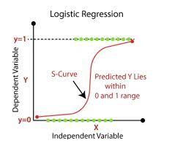
It comes under Supervised learning technique.
As Logistic regression predicts the output of a categorical dependent variable, it gives the probabilistic values which lie between 0 and 1.
In logistic regression we fit an "S" shaped logistic function, which predicts two maximum values (0 or 1).

Slide 9
Software
Window: Python 3.10.6 or above, PIP and JUPYTER NOTEBOOK
Python: Python contains a sizable and thorough standard library that covers a wide range of typical programming operations, including establishing connections to web servers, conducting regular expression searches on text, and reading and editing files. For a variety of tasks, including web development, machine learning, data science, and scientific computing, there are numerous libraries and frameworks accessible. In the business world, Python is also frequently used for numerous tasks like web scraping, data analysis, automation, and artificial intelligence.
PIP: It enables users to quickly download, set up, and manage a variety of packages and the dependencies that go with them. Developers may now share and reuse code with ease, as well as use and incorporate third-party libraries into their projects. a few of the most well-liked

Slide 10
DATASET
The Kaggle website, which is open to the public, is used. A digitised breast mass picture that identifies the properties of the cell nuclei in the image is used to identify the attributes.
There are 33 columns and 569 rows in it. The properties for each cell nucleus are the ID number, diagnostic (M1 = malignant, B1 = benign), and 10 real valued features.

Slide 11
To implement the Logistic Regression using Python, we will use the following steps:
Data Pre-processing
Fitting Logistic Regression to the Training set
Predicting the test result
Test accuracy of the result
Visualizing the test set result.

Slide 12
Attribute Information:
diagnosis: M = malignant, B = benign
In the given project, the tumour can be classified as Benign tumour (non-cancerous) or Malignant tumour (cancerous).

Slide 13
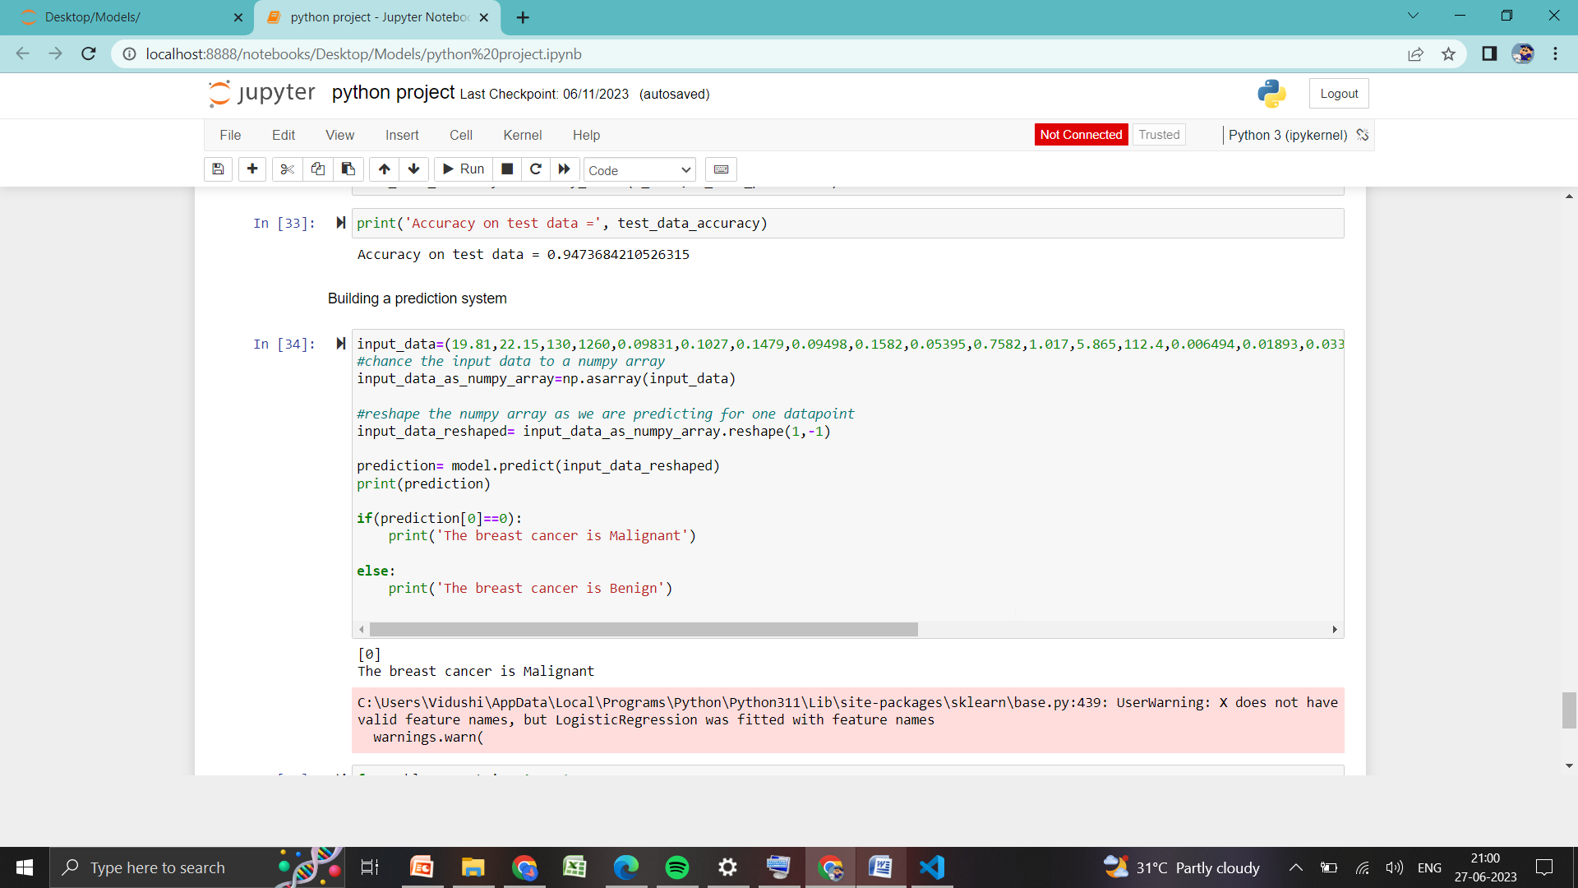
CONCLUSION

Slide 14
THANK YOU

